Slide 1
War’s Economic & Social Impact
Analytical Dashboard
Kefyalew Abaroro
Date: 26,2026

Slide 2
Overview
This presentation summarizes the economic and social consequences of war using a multi‑indicator dataset covering GDP, unemployment, poverty, inflation, informal economy activity, black‑market dynamics, and reconstruction costs.
Focus Areas
Macroeconomic deterioration
Labor market disruption
Poverty escalation
Inflation and currency instability
Informal and black‑market expansion
Reconstruction burden

Slide 3
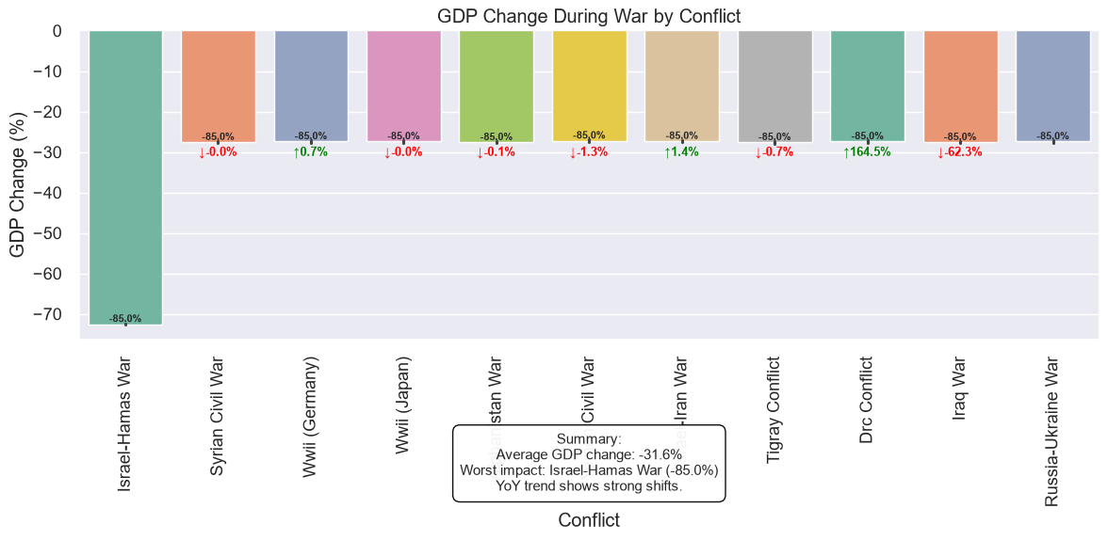
Economic Impact: GDP Decline
Insight: Most conflicts show significant negative GDP change, reflecting broad macroeconomic contraction.
Drivers
Destruction of productive assets
Reduced investment and trade
Displacement of labor
Supply chain collapse
Implication: GDP decline is a consistent early indicator of long‑term recovery difficulty.

Slide 4
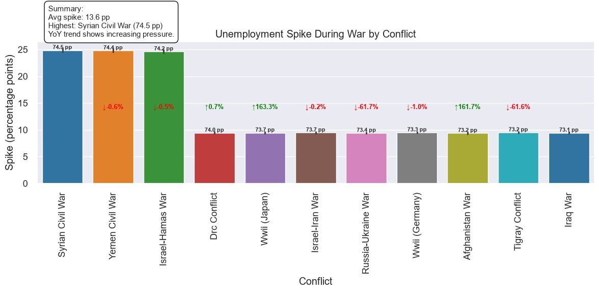
Economic Impact: Unemployment Spike
Insight: Unemployment rises sharply during conflict due to labor displacement, sector shutdowns, and loss of formal employment.
Patterns
Youth unemployment increases fastest
Informal labor replaces formal jobs
Conflict intensity correlates with unemployment spikes
Implication: Labor market instability amplifies poverty and slows post‑war recovery.

Slide 5
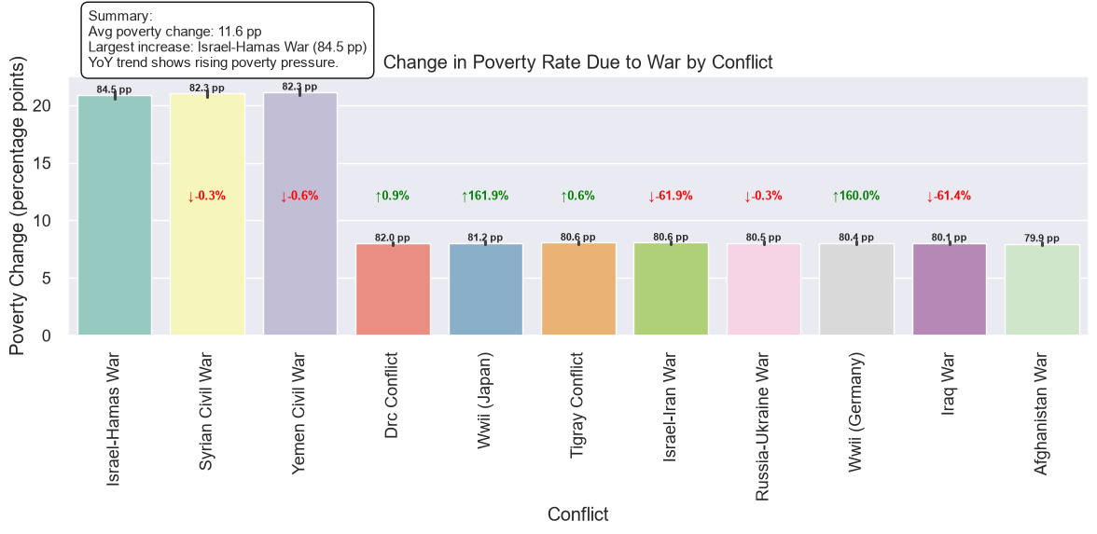
Social Impact: Poverty Increase
Insight: Poverty rates rise across nearly all conflicts, with many households falling into poverty during war.
Drivers
Job loss
Inflation & food insecurity
Collapse of social services
Supply chain disruption
Implication: Poverty escalation is one of the most persistent long‑term social impacts of conflict.

Slide 6
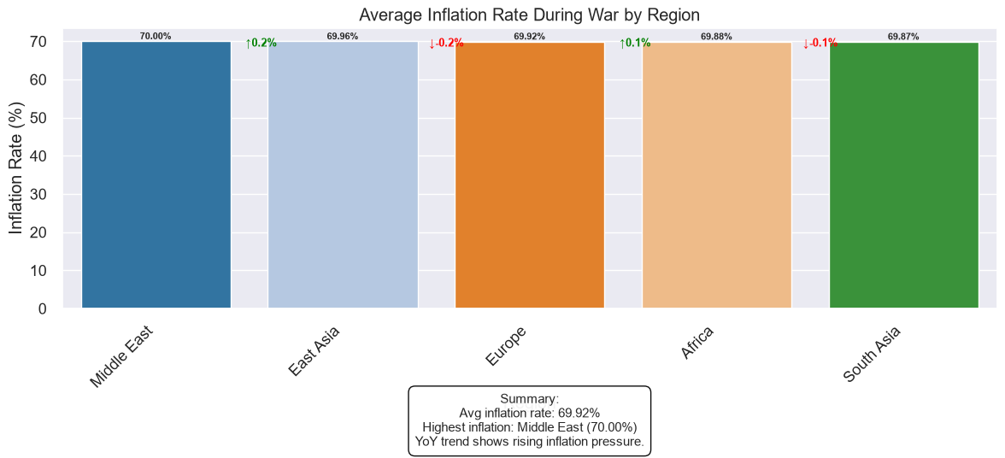
Inflation & Currency Instability
Insight: Inflation increases significantly in conflict regions, often accompanied by currency devaluation.
Observed Trends
Sharp price increases for essentials
Currency instability drives black‑market exchange rates
Prolonged conflicts show the highest inflation
Implication: Inflation erodes purchasing power and accelerates poverty.

Slide 7
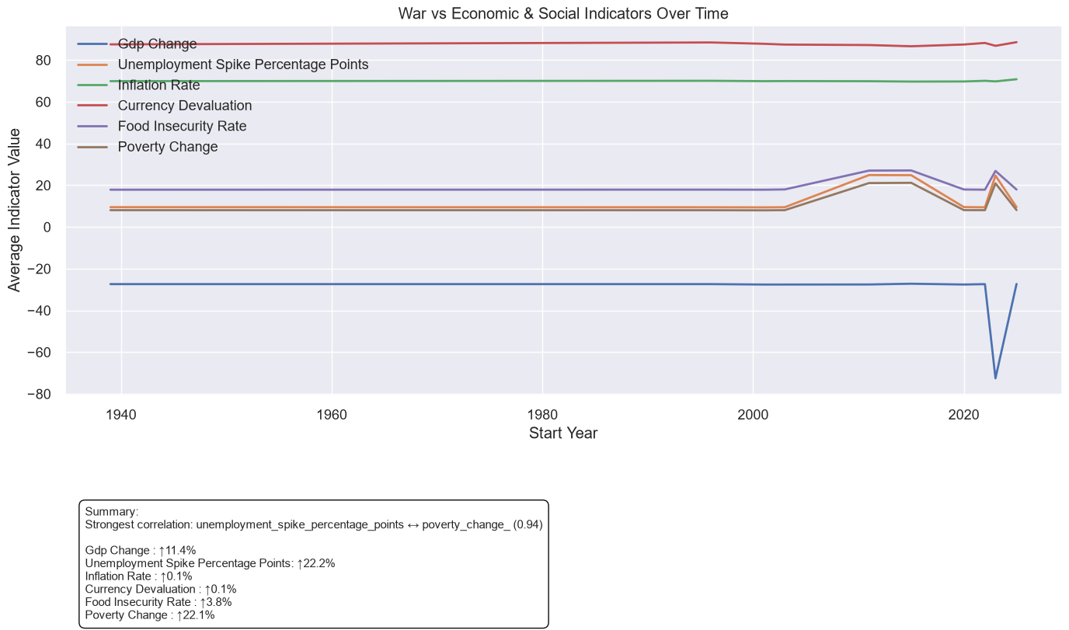
Economic & Social Linkages
Key Insight
War consistently drives sharp increases in unemployment and poverty, which rise together more than any other indicators. Inflation, currency devaluation, and food insecurity also trend upward, but the strongest pattern is the tight link between labor market collapse and poverty escalation.

Slide 8
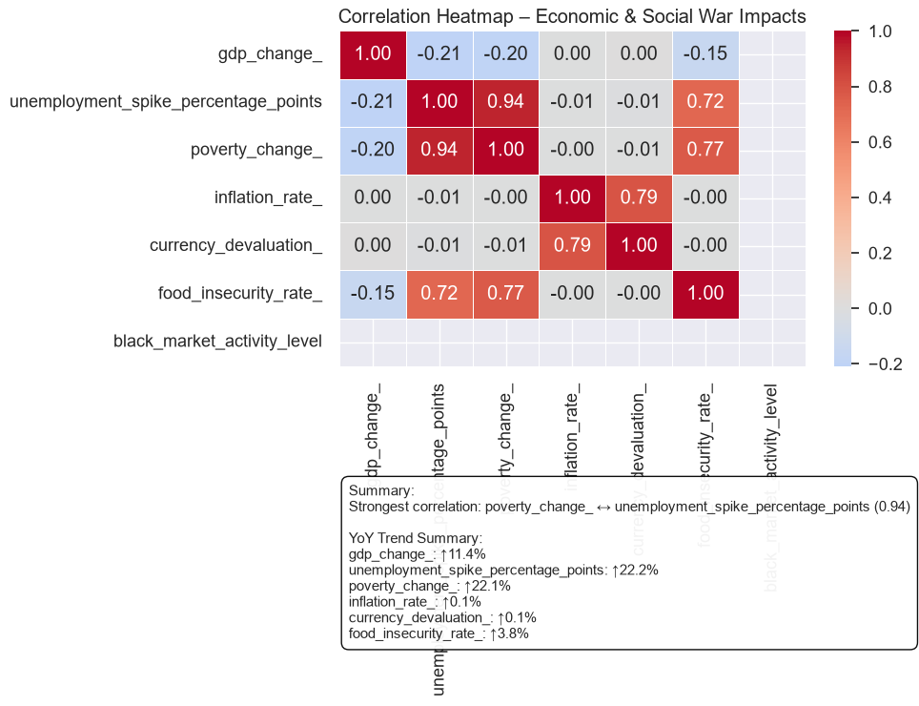
Correlation Insight
Unemployment spikes and poverty increases move almost identically during conflict — the strongest relationship in the dataset. Inflation, currency devaluation, and food insecurity also rise together, reinforcing how economic shocks compound social stress.

Slide 9
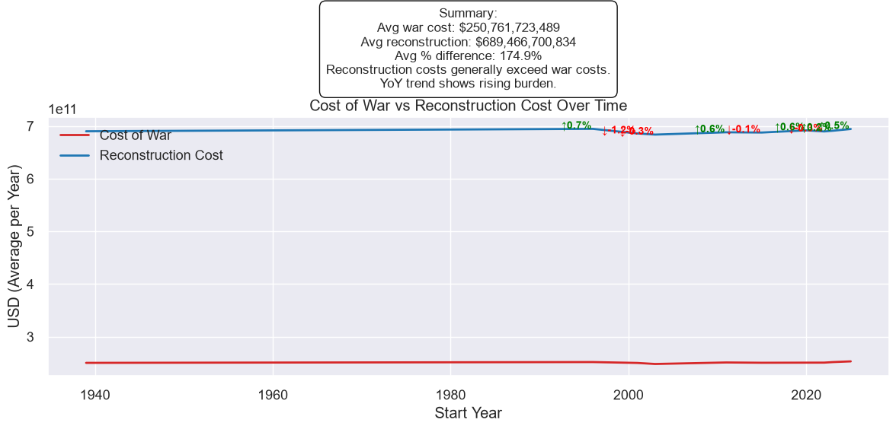
Reconstruction Burden
Insight: Reconstruction cost strongly correlates with war cost — more destructive conflicts require substantially higher investment.
Correlation: War Cost ↔ Reconstruction Cost (high positive correlation)
Implication: Reconstruction planning must account for conflict intensity, not just duration.

Slide 10
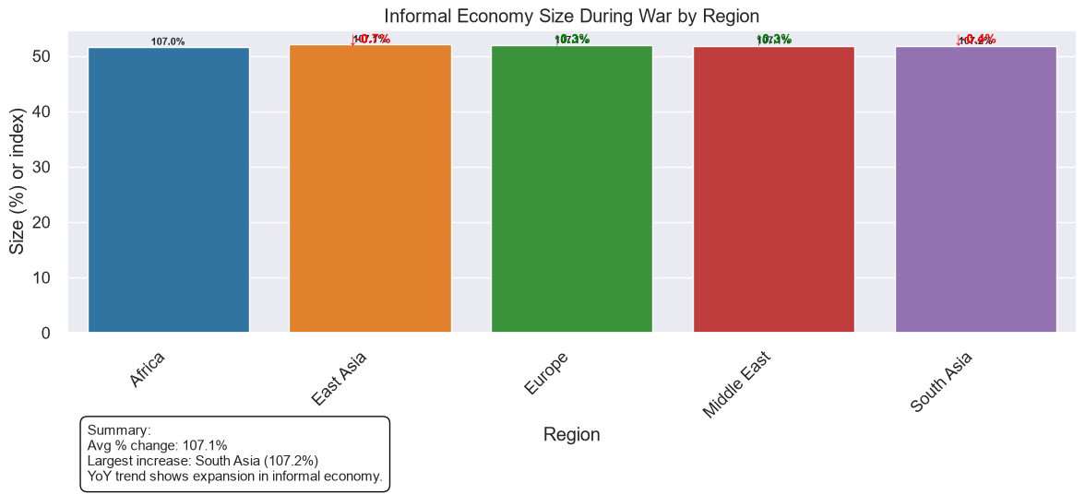
Informal Economy & Black‑Market Activity
Key Insight: Informal economic activity expands during conflict as formal systems weaken.
Indicators
Growth in black‑market goods
Increased currency black‑market rate gaps
Documented war profiteering in several conflict types
Implication: Informal markets fill gaps left by weakened institutions but increase governance challenges.

Slide 11
Executive Summary
Message Copilot
War produces predictable patterns of economic and social disruption:
Economic deterioration: GDP decline, unemployment spikes, inflation
Social pressure: poverty increase, food insecurity, informal economy growth
Structural strain: currency instability, black‑market expansion
Financial burden: reconstruction cost scales with war intensity
These patterns highlight the need for coordinated economic, humanitarian, and governance interventions.

Slide 12
Recommendations
Short‑Term
Emergency employment programs
Stabilization of essential goods supply
Targeted poverty relief
Currency stabilization measures
Long‑Term
Institutional rebuilding
Infrastructure reconstruction
Anti‑profiteering and governance reforms
Investment in formal labor markets

Slide 13
Thank you
Questions & Discussion

